Slide 1
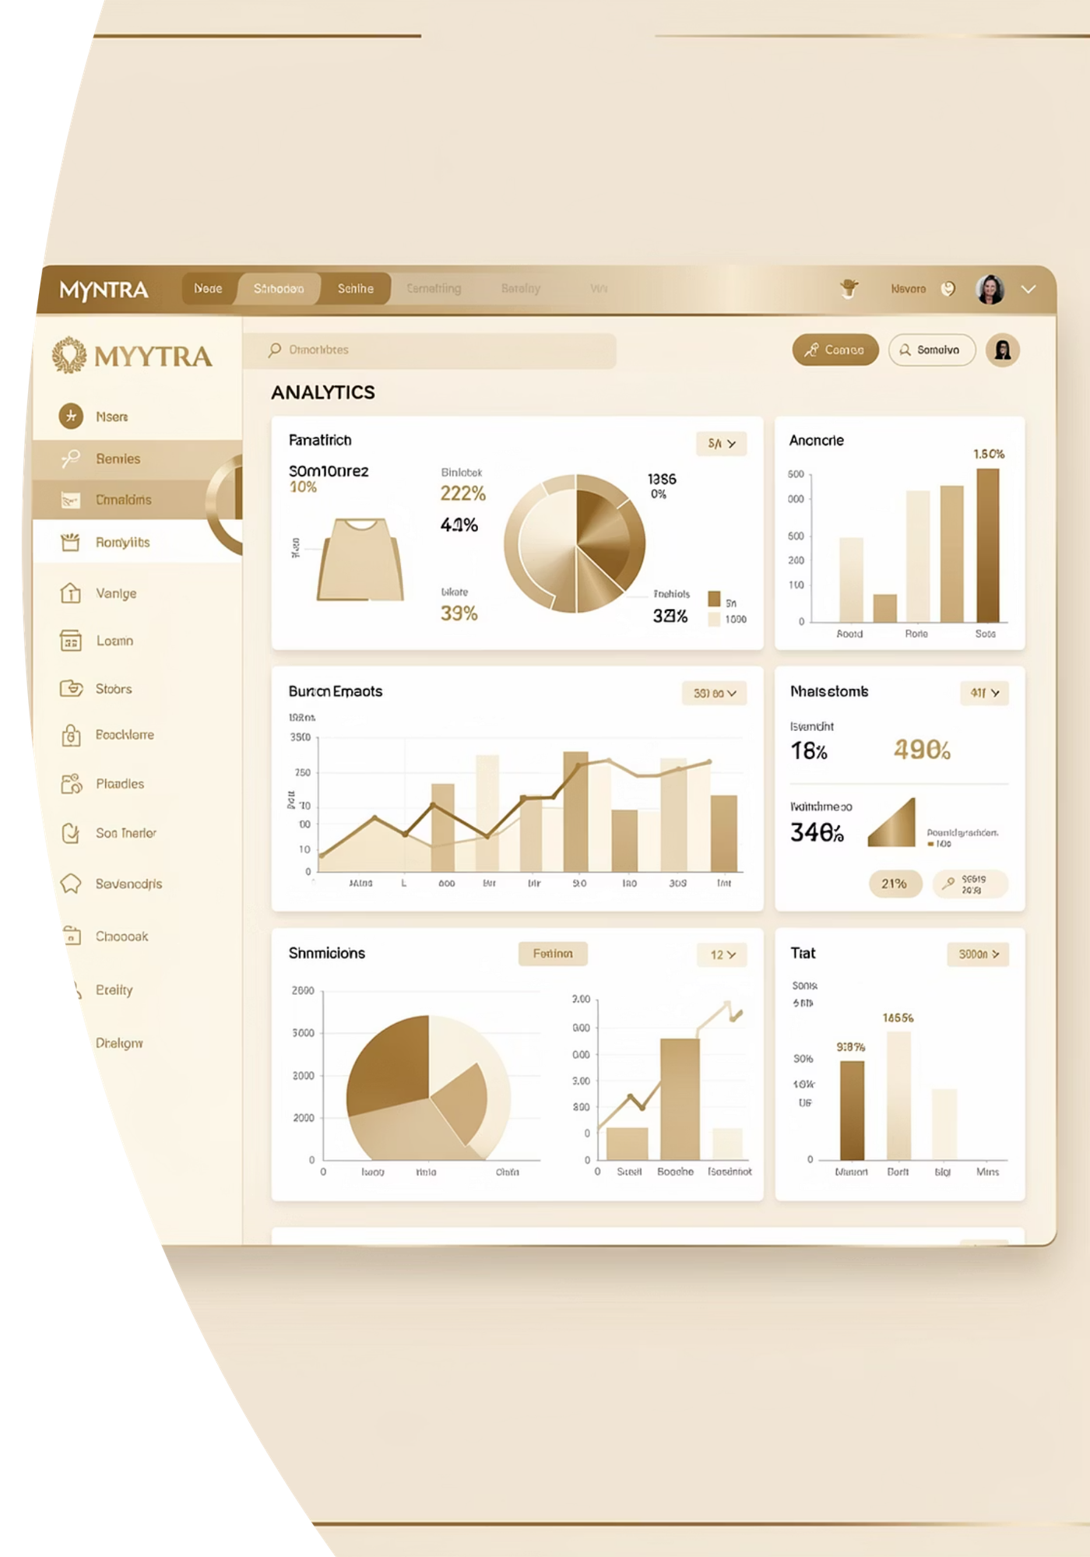
Myntra Product Analysis
Uncovering customer behavior through data-driven insights

Slide 2
OVERVIEW
7 Key Analyses
01
02
03
Discount Impact
Brand Performance
Price Sensitivity
How discounts drive engagement
Top-performing brands identified
Price effects on ratings
04
05
06
Discount Preference
Category Analysis
Value Products
Customer discount behavior
Best-performing categories
High quality, low price finds
07
Data Quality
Handling missing ratings

Slide 3


ANALYSIS 1
Discount Impact on Engagement
Discount Ranges
Analysis groups products by discount level and measures total reviews to gauge customer engagement.
Less Discount
Mid Discount
High Discount
<35% off
35-60% off
>60% off

Slide 4

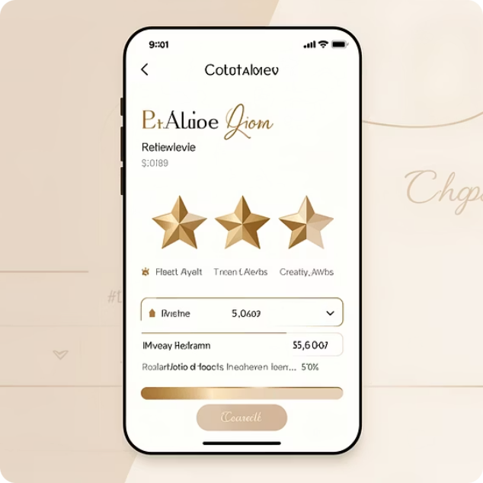
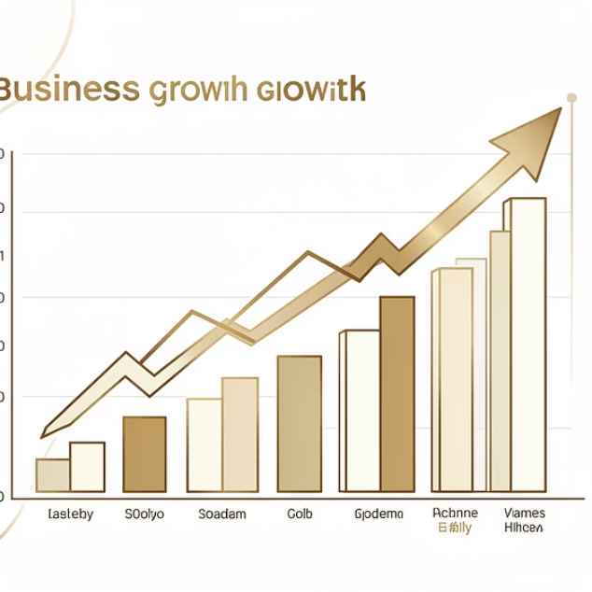

ANALYSIS 2
Top Performing Brands
Product Count
Average Rating
Weighted Rating
Total products per brand
Quality indicator
Rating × total reviews
Filters brands with 100+ ratings for statistical significance

Slide 5
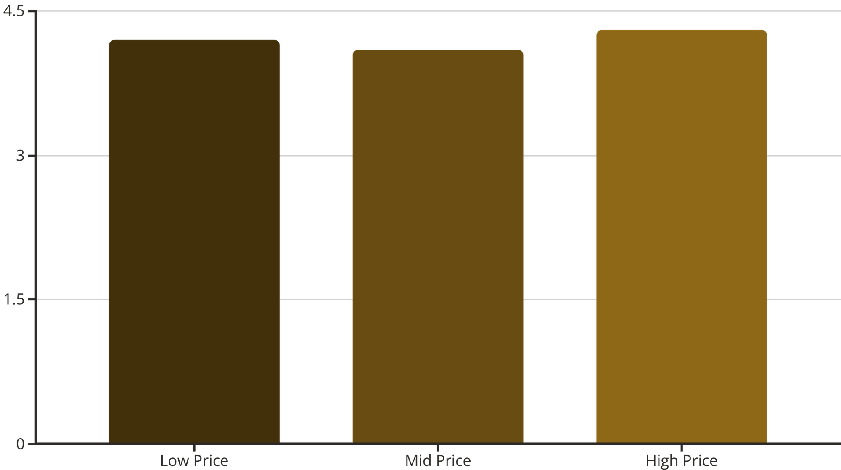
ANALYSIS 3
Price Sensitivity Analysis
Does Price Affect Ratings?
Examines correlation between product price and customer satisfaction ratings.
Low Price
Mid Price
High Price
<₹500
₹500-₹2,000
>₹2,000

Slide 6

ANALYSIS 4
Customer Discount Preference
Zero Discount
Products with no discount
Total reviews tracked
Discounted
Products with any discount
Engagement comparison
Reveals whether customers engage more with discounted vs. non-discounted products.

Slide 7

ANALYSIS 5
Category Performance
What Makes Categories Succeed?
Calculate
Compute weighted rating: reviews × rating
Reviews volume indicates popularity
Average rating shows quality
Weighted rating combines both metrics
Only categories above platform average included
Filter
Rank
Keep categories above average
Order categories by weighted score

Slide 8



ANALYSIS 6
Value-for-Money Products
High Rating
>4 stars
High Discount
>85% off
Low Price
<₹1,000
Identifies best deals: products combining exceptional discounts, quality ratings, and affordability.

Slide 9
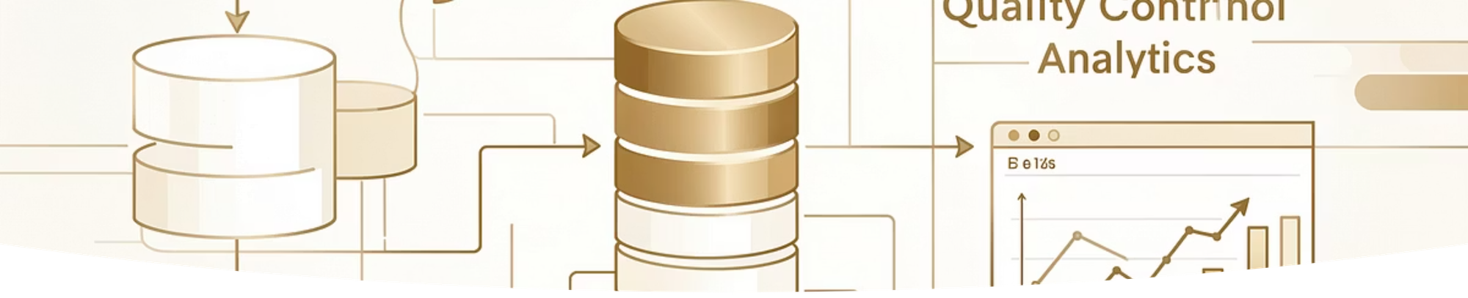
ANALYSIS 7
Data Quality Management
Filter Criteria
Null Handling
Sort Order
Rating count: 101 to maximum
Exclude missing ratings
Ascending by rating count

Slide 10
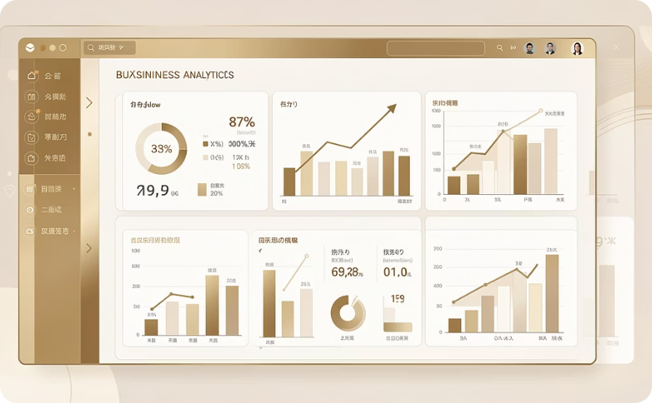
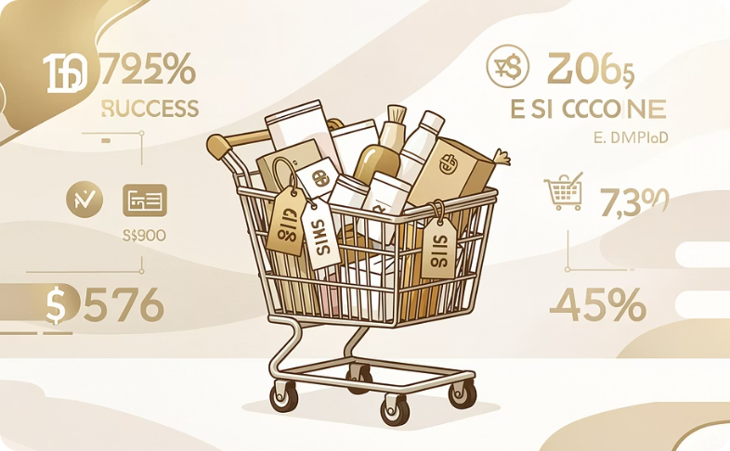
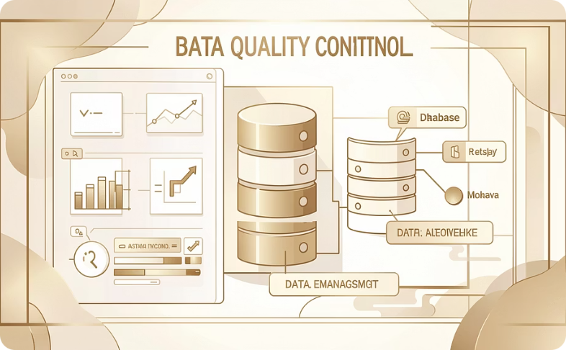
SUMMARY
Key Takeaways
Comprehensive Analysis
Actionable Insights
Data-Driven Decisions
7 SQL queries reveal customer behavior patterns
Discount impact, brand performance, price sensitivity
Reliable metrics through proper data handling

